Slide 1
Health & Sanitation Event Tracker
Team Members
Abhishek Gupta
Anil Shrestha
Sameer Shrestha
Sanjeev Mainali

Slide 2
Problem Background
Most of the public are not aware of events. (Bagmati Cleanliness Campaign)
Very few platforms to share the event details. (sanitation, cleanliness etc)
Available platforms to share are (sms - ntc), friend circles, facebook event, newspapers etc.)
People often misses those events….

Slide 3
What we did…
A platform to share and update the upcoming events.
Comparison & findings of available data. (health & sanitation related data)

Slide 4
Benefits / Impacts …
Governmental / Organizational bodies can easily share the events that allows for public participation.
Users / public can easily view the necessary details regarding the event.
Two or more organization can collaborate to organize the event.
Using chart, one can easily identify the area that needs to be focused more regarding sanitation and cleanliness.

Slide 5
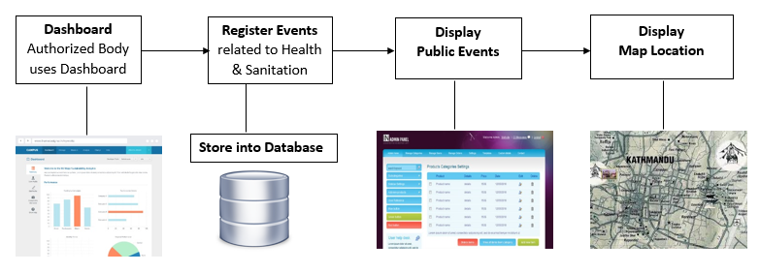
General Work-Flow

Slide 6
Let’s move to DEMO
Data source: data.opennepal.net

Slide 7
Thank You !!

